Slide 1




Desktop-Based Quiz Management System
PRESENTED BY
Niravbhai Savaliya && YashKumar Sarena
July 27, 2026
Made with SlideMaker.app

Slide 2







Desktop-Based Quiz Management System
This presentation explores the development and implementation of a Desktop-Based Quiz Management System, highlighting its features, technology stack, and potential impact on educational assessments. Join us as we delve into this innovative solution for effective learning.
Made with SlideMaker.app

Slide 3


Problem Statement
Inefficient Quiz Management
User Interface Challenges
Current systems often require manual processes, leading to delays and errors in quiz administration.
Many existing platforms lack intuitive designs, making it difficult for users to navigate and utilize effectively.
Need for Real-Time Tracking
Educators require immediate insights into student performance to adapt teaching strategies and improve outcomes.
Made with SlideMaker.app

Slide 4


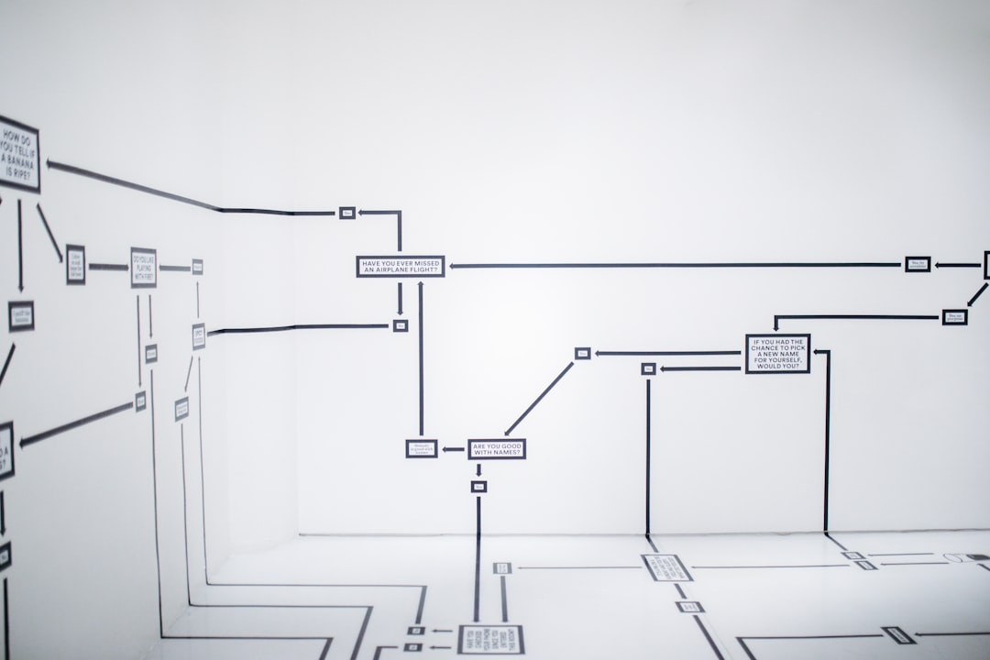
Technology Stack Overview
Java & JavaFX Development
JDBC for Database Connectivity
MySQL for Data Storage
Java provides a robust platform, while JavaFX enhances UI with modern graphics and controls.
JDBC enables seamless interaction between Java applications and MySQL databases for data management.
MySQL is a reliable relational database, supporting complex queries and transactions efficiently.
Made with SlideMaker.app

Slide 5
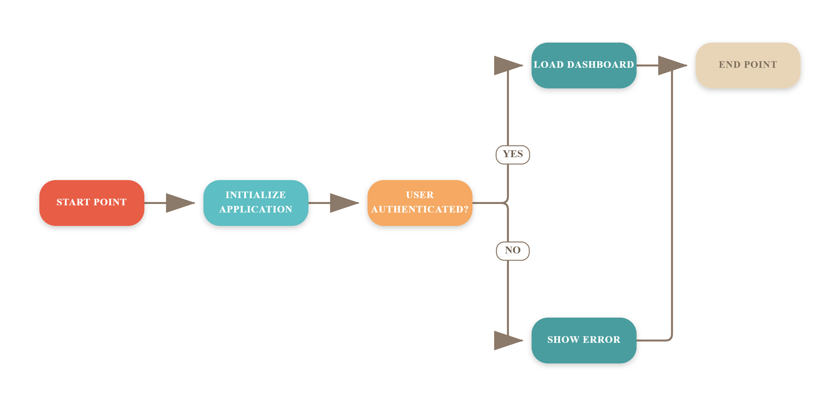
System Architecture Workflow
Made with SlideMaker.app

Slide 6









Key Features
Interactive Quizzes
Secure User Authentication
Performance Analytics
Engaging quizzes that enhance learning through real-time feedback.
Robust security measures to protect user data and ensure privacy.
Detailed analytics to track student performance and quiz effectiveness.
User-Friendly Interface
Centralized Database
Intuitive design that simplifies navigation for both admins and students.
Efficient data management with a MySQL database for storing quiz data.
Made with SlideMaker.app

Slide 7

Challenges & Future Scope
User Feedback Integration
Scalability Issues
Incorporating user feedback can enhance usability, leading to a 30% increase in user satisfaction.
Ensuring the system can handle 10,000+ concurrent users is crucial for future growth and performance.
Online Platform Integration
Integrating with platforms like Moodle can expand reach, improving accessibility for diverse learning environments.
Made with SlideMaker.app

Slide 8

Key Takeaways
The Desktop-Based Quiz Management System enhances educational engagement through efficient quiz administration, user-friendly interfaces, and robust data management. Future enhancements could include mobile compatibility and AI-driven analytics for personalized learning experiences.
Made with SlideMaker.app

